Slide 1
Use GAN to generate a series of images
Zheng Lu

Slide 2
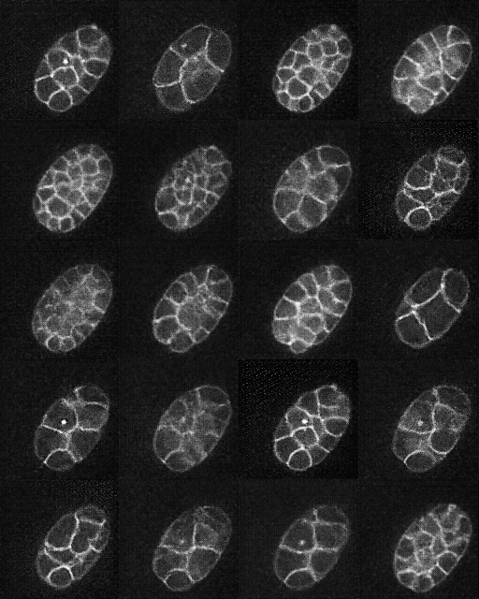
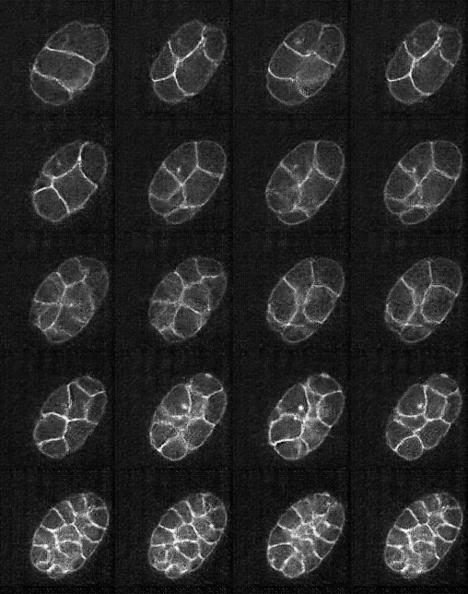
Unconditional GAN
Conditional GAN
20-30 min
30-40 min
40-50 min
50-60 min
60-70 min

Slide 3
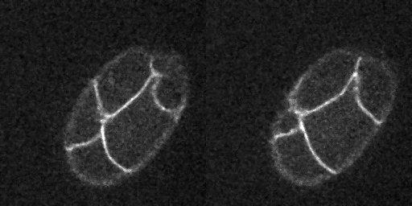
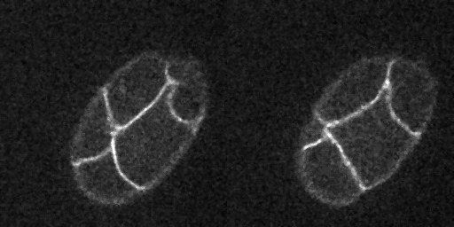
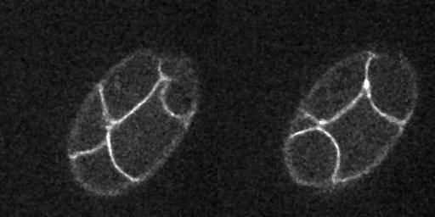
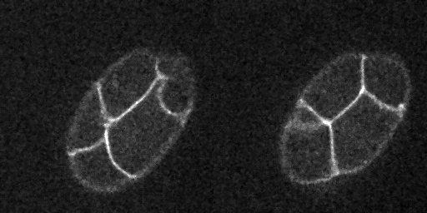
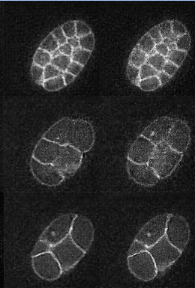
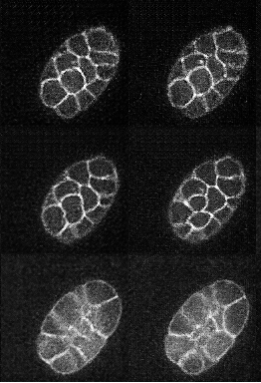
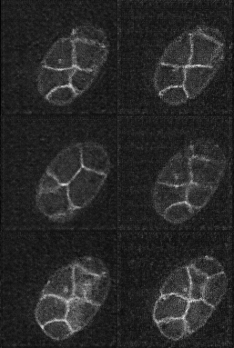
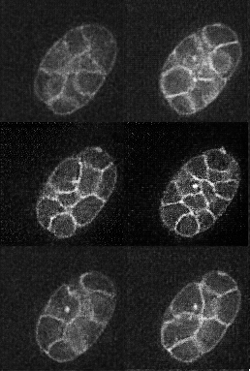
1 min interval
2 min interval
4 min interval
8 min interval
Real Images
Generated Images

Slide 4
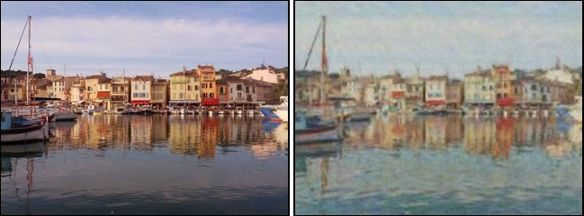
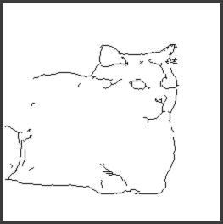
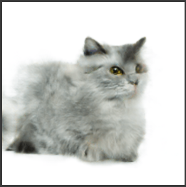
Results in previous works – Image translation
Figures are borrowed from [2,3]

Slide 5
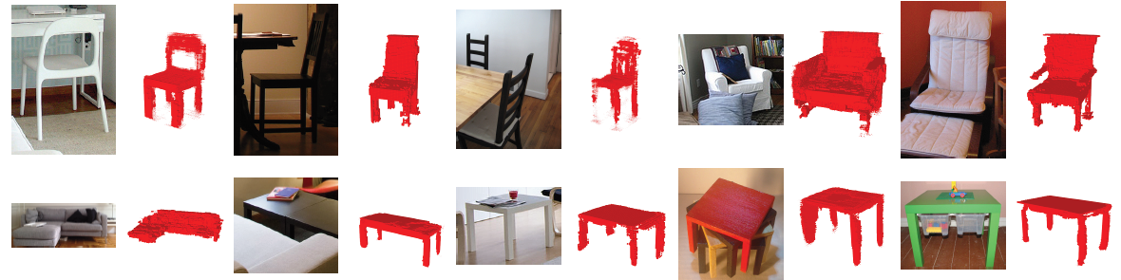
Results in previous works – 3D image generation
Figures are borrowed from [4]

Slide 6
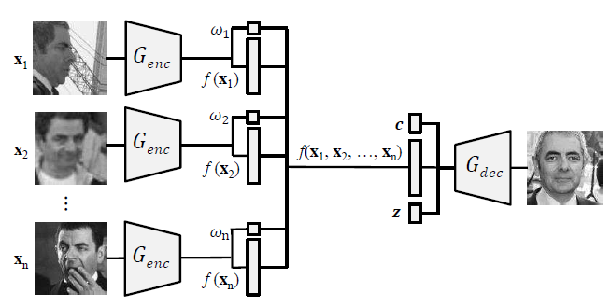
Results in previous works – Face rotation
Figures are borrowed from [1]

Slide 7
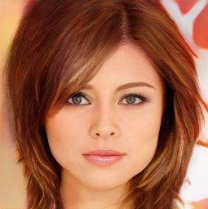
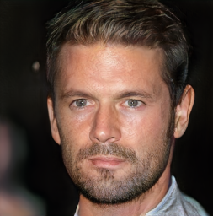
Results in previous works – Growing GAN
Figures are borrowed from [5]

Slide 8
References
[1] Disentangled GAN
Tran, Luan, Xi Yin, and Xiaoming Liu. "Disentangled representation learning gan for pose-invariant face recognition." CVPR. Vol. 3. No. 6. 2017.
[2] pix2pix GAN
Isola, Phillip, et al. "Image-to-image translation with conditional adversarial networks." arXiv preprint (2017).
[3] CycleGAN
Zhu, Jun-Yan, et al. "Unpaired image-to-image translation using cycle-consistent adversarial networks." arXiv preprint arXiv:1703.10593 (2017).
[4] 3DGAN
Wu, Jiajun, et al. "Learning a probabilistic latent space of object shapes via 3d generative-adversarial modeling." Advances in Neural Information Processing Systems. 2016.
[5] Progressive growing of GANs
Karras, Tero, et al. "Progressive growing of gans for improved quality, stability, and variation." arXiv preprint arXiv:1710.10196 (2017).

